Slide 1
Retrieval-Augmented Generation System
Eric Wu | Gregory Zeng
GitHub: Imatry-Notalose

Slide 2
Table of contents
01
06
02
07
08
03
04
09
05
Overview
Experimental Design
Data
Vector Databases
Embedding Models
Data Analysis
Data Processing
Recommendation
LLMs

Slide 3
01
Overview
Elevator Pitch

Slide 4
Elevator Pitch
Our project involves building a local Retrieval-Augmented Generation (RAG) system that enables users to query DS4300 course materials collected throughout the semester
We implemented a full pipeline that extracts and preprocesses text, explores multiple chunking strategies, compares three embedding models, and tests vector storage using Redis, FAISS, and ChromaDB
Retrieved content is fed into local LLMs (Llama 3 and Mistral) to generate natural language responses
The system evaluates performance based on speed, memory usage, and output quality across different configurations

Slide 5
02
Vector Databases
Database Selection | Results

Slide 6
Database Selection
Redis Vector DB
In-memory, fast retrieval with HNSW indexing
Great performance, but higher memory usage
ChromaDB
Simple, disk-based vector DB for local setups
Easy to use, slower indexing in our tests
FAISS
High-speed library for similarity search
Efficient and lightweight, but lacks built-in metadata handling

Slide 7
Results
FAISS and Redis offered fast indexing and querying with low memory usage, making them efficient for lightweight search tasks
ChromaDB had higher memory use and slower indexing but may offer more flexibility for complex vector queries

Slide 8
03
Embedding Models
Model Selection | Results

Slide 9
Model Selection
MiniLM (all-MiniLM-L6-v2)
A lightweight model that runs quickly and uses minimal memory
It’s ideal for fast retrieval tasks, though it may miss subtle contextual details
MPNet (all-mpnet-base-v2)
Offers richer embeddings with better contextual understanding
Slightly slower and more memory-intensive, but improves retrieval accuracy
GTE-Small (thenlper/gte-small)
An open-source model with balanced performance
It’s efficient and versatile, making it a good middle ground between MiniLM and MPNet

Slide 10
Results
MiniLM is the fastest model with moderate memory usage, suitable for quick retrieval tasks but shows lower embedding similarity
GTE-Small offers the best balance with high similarity scores and low memory usage, making it ideal for both performance and semantic consistency

Slide 11
04
Data Processing
Components | Processing Files

Slide 12
Components
Preprocessing
Clean and extract text from various file formats
Support for .pptx and .pdf
Chunking
Tunable chunk_size (200, 500, 1000) and overlap (0, 50, 100)
Ensures semantic preservation across contexts
Embedding
Supports multiple models:
MiniLM (all-MiniLM-L6-v2)
MPNet (all-mpnet-base-v2)
GTE-Small (gte-small)
Storage
Stores embeddings in Redis for fast retrieval
Efficient memory monitoring and usage tracking
Retrieval + Querying
Retrieves relevant documents using cosine similarity
Queries local LLMs like llama3.2:1b and mistral:v0.1

Slide 13
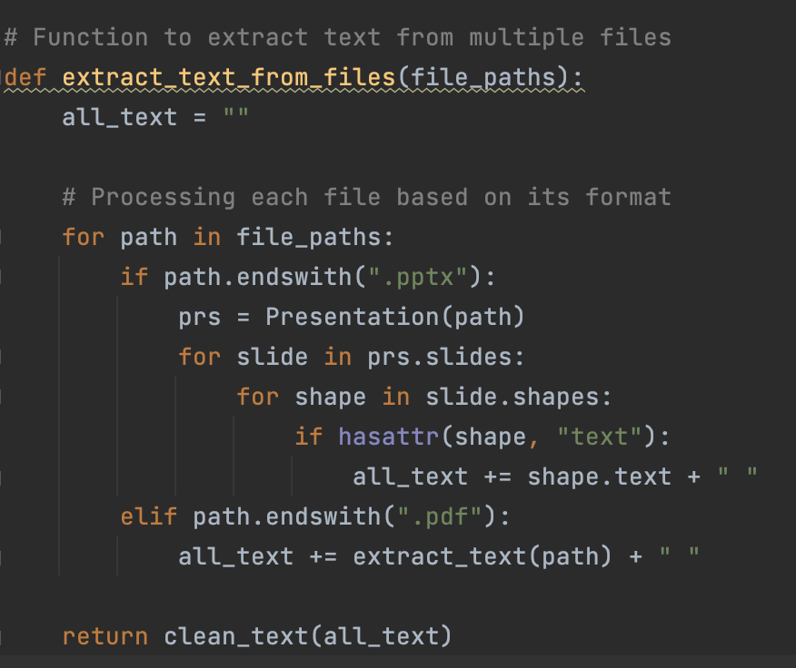
Processing Files
Read in documents/file paths outside the function
This function extracts and consolidates text content from a list of files, specifically supporting PowerPoint and PDF formats. For each file:
If it's a .pptx, it reads the text from all shapes in every slide
If it's a .pdf, it uses a PDF extraction tool to retrieve the text content
Returns a cleaned and combined string of all extracted text for downstream processing

Slide 14
05
LLMs
LLM Selection

Slide 15
LLM Selection
LLaMA 3 (llama3.2:1b)
A compact local model from Meta
Performs well on structured questions
Fast inference and low resource usage
Occasionally limited in handling abstract prompts
Mistral (mistral:v0.1)
More expressive and creative in responses
Stronger performance on open-ended or nuanced queries
Slightly slower than LLaMA 3 but more detailed answers

Slide 16
06
Experimental Design
Pipeline Experiments

Slide 17
Pipeline Experiments
Tested 27 chunking variations (3 sizes × 3 overlaps) to explore how text segmentation affects retrieval
Combined each chunking strategy with three embedding models (MiniLM, MPNet, GTE-Small) to evaluate differences in representation quality
Used Redis as the primary vector database for storing and searching embeddings
Queried each setup using real user questions related to course material

Slide 18
Pipeline Experiments
Responses were generated using both LLaMA 3 and Mistral, allowing direct comparison of LLM output quality
Logged and reviewed results to assess:
Memory and computation time
Retrieval relevance
LLM response clarity and completeness

Slide 19
07
Data
Data Collection | Data Interpretation

Slide 20
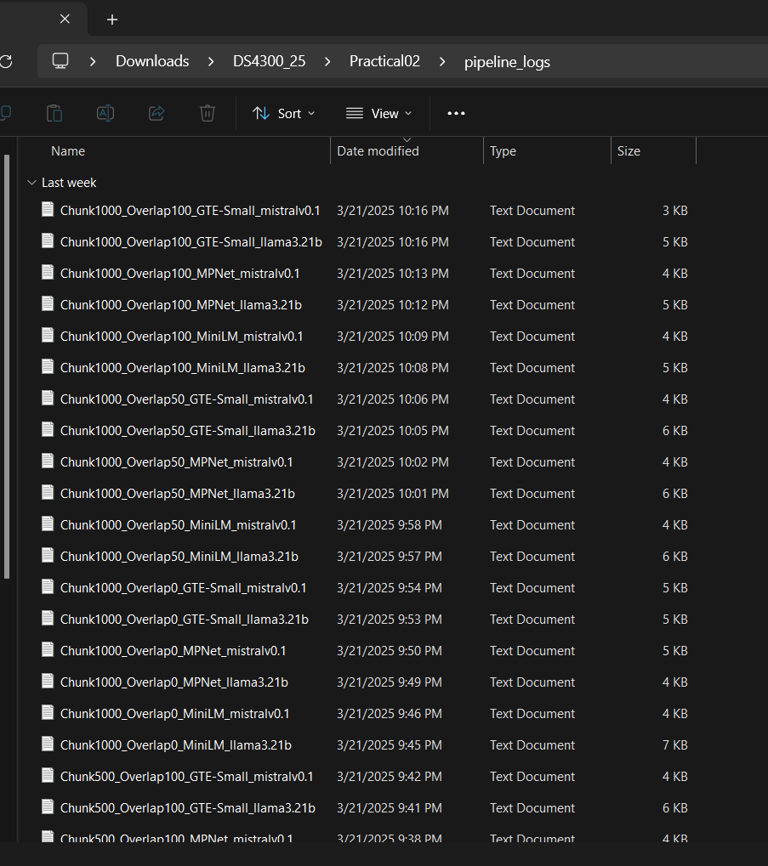
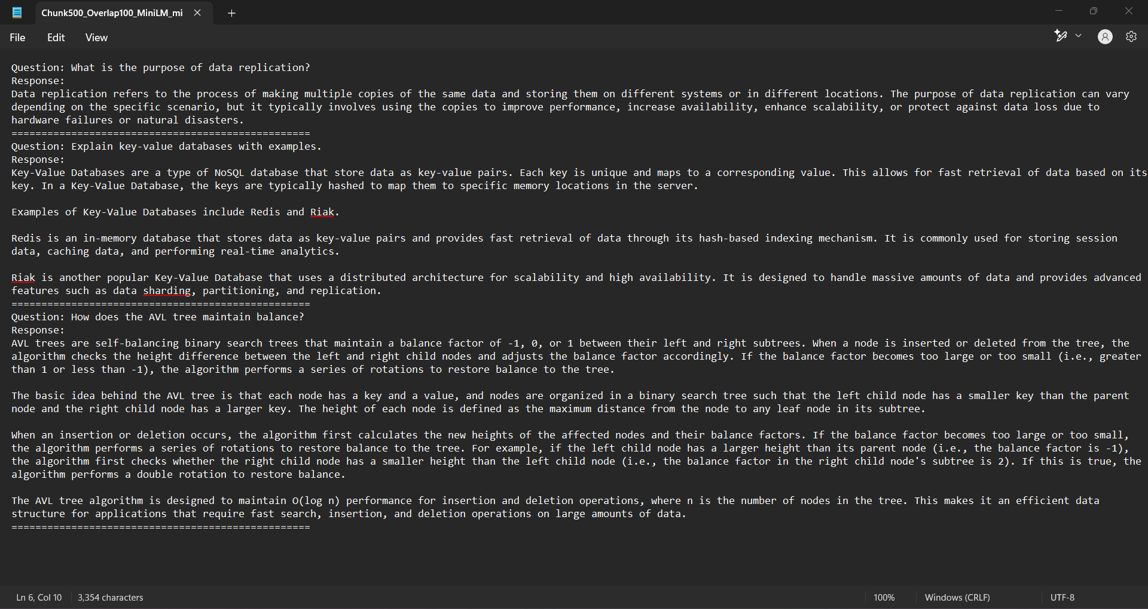
Data Collection
Fig. 1 Pipeline logs of all the combinations between embedded models, vector DBs, and LLMs (left); Fig. 2 A sample output of the Mistral LLM response text file (right)

Slide 21
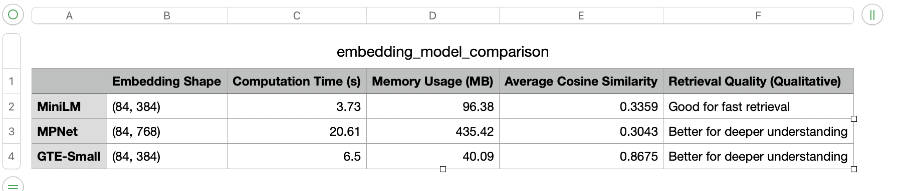
Data Collection (cont.)
Fig. 3 Table of embedded model comparisons between MiniLM, MPNet, and GTE-Small between computation time, memory usage, average cosine similarity, and overall retrieval quality

Slide 22
Data Interpretation
Response Quality: We assessed the clarity, accuracy, and relevance of the generated answers (This was done through manual evaluation on a 1–5 scale)
Latency (Response Time): We measured how long each pipeline took to return a response after receiving a query (This helped us understand the trade-off between speed and quality)
Token Usage: We tracked how many tokens were generated per response (This gave insight into verbosity and completeness)
Memory Usage: We recorded the amount of memory each embedding model used during retrieval (This was important for understanding deployment feasibility on limited hardware)
Semantic Similarity Scores: We calculated similarity between the user’s query and the retrieved chunks using cosine similarity (Higher scores indicated better matches)
Context Retention: We evaluated how well each model maintained coherence in multi-turn conversations or when responding to compound questions

Slide 23
08
Data Analysis
Set of User Questions | Parameters

Slide 24
Set of User Questions
What is the purpose of data replication?
Explain key-value databases with examples.
How does the AVL tree maintain balance?

Slide 25
Parameters
Accuracy & Fluency: Mistral produced more accurate, coherent, and context-aware responses
Speed & Efficiency: Llama3.2:1b was faster and more lightweight, better for low-resource environments
Domain Understanding: Mistral handled technical language and tone more effectively
Robustness: Mistral showed greater reliability under edge cases and adversarial inputs

Slide 26
09
Recommendation
Which is better for an exam?

Slide 27
Final Recommendation - Mistral
Clear, Focused Responses: Mistral excels at generating concise, easy-to-understand answers (perfect for studying)
Lightweight & Efficient: Runs smoothly on limited resources, ideal for a small team without access to heavy infrastructure
Strong Context Handling: Great at rephrasing notes and connecting related concepts (helpful for reviewing and clarifying material)
Reliable on Academic Content: Performs well in technical and educational domains, especially when grounded with retrieved content
For a team of 2 building a focused, exam-ready study assistant, Mistral is the right balance of clarity, performance, and deployability—helping students not just find answers, but understand them

